Slide 1
Bluetooth Controlled Car using ESP32
Project by:
Mayank(2204030400233)
Akshar(220403040084)
Bhargav(2204030400143)
Uttam(2204030400121)
Bhavyesh(2204030400127)

Slide 2
Intro ABOUT PROJECT:
This project is a Bluetooth controlled car using an ESP32 microcontroller. The car is controlled via a mobile application, sending commands to the ESP32, which then drives the DC motors through an L298N motor driver.

Slide 3
Components Required:
ESP32 Microcontroller
L298N Motor Driver
4 DC Motors
Power Supply (Battery 9V-12V)
Platform and Wheels
Jumper Wires
Mobile Application (Bluetooth Controller App)

Slide 4
ESP32 Microcontroller:
ESP32 is a microcontroller with built-in Wi-Fi and Bluetooth capabilities. It receives Bluetooth signals from the mobile app and sends control signals to the L298N motor driver to move the car.

Slide 5
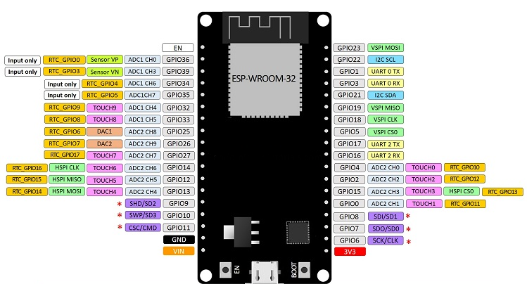
ESP 32 Pinout:

Slide 6
L298N Motor Driver
The L298N motor driver allows controlling the direction and speed of DC motors using PWM signals from the ESP32. It has two H-Bridge circuits to drive two motors independently.

Slide 7
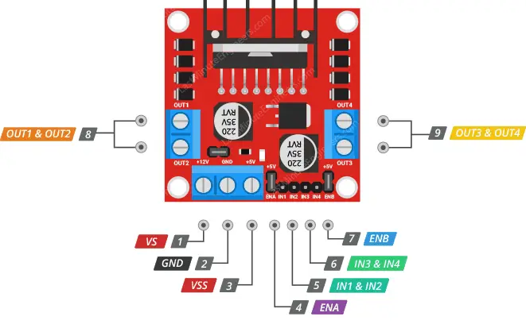
L298N Motor driver pinout:

Slide 8
DC Motors:
The car uses four DC motors for movement. The direction and speed of these motors are controlled by the L298N motor driver, which is regulated by the ESP32.

Slide 9
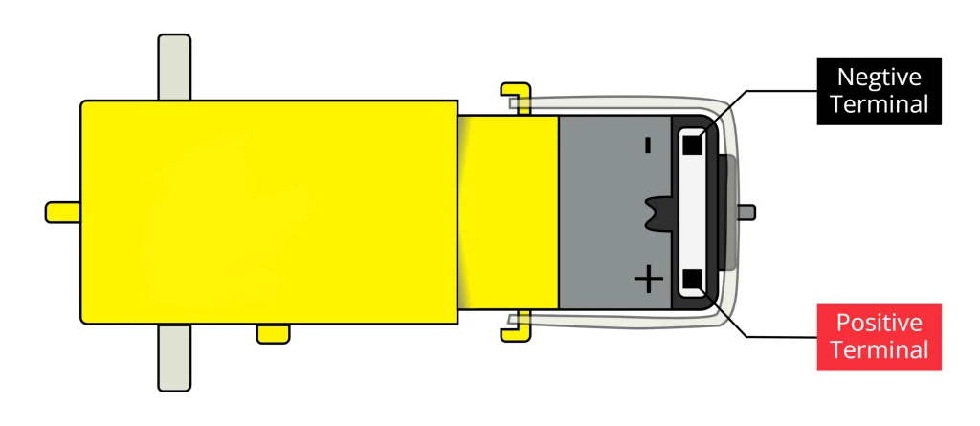
DC motor pinout:

Slide 10
Connection:
1. ESP32 to L298N:
- IN1, IN2, IN3, IN4 → ESP32 GPIO pins
- ENA, ENB → ESP32 PWM pins
2. L298N to Motors:
- Output 1 → Motor 1 & 2
- Output 2 → Motor 1 & 2
- Output 3 → Motor 3 & 4
- Output 4 → Motor 3 & 4
3. Power Supply:
- Battery to L298N (9V-12V)
- ESP32 powered via USB or regulator from L298N

Slide 11
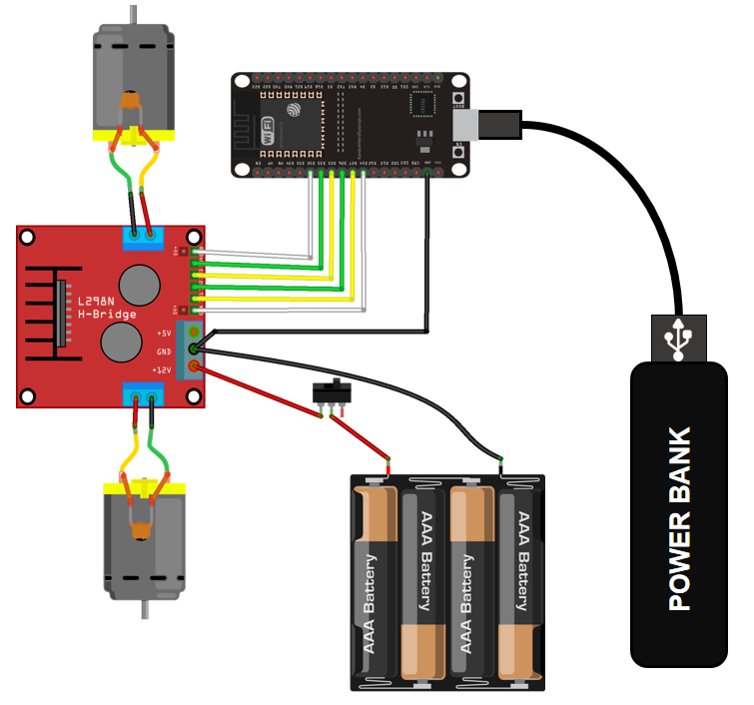
Connection diagram:

Slide 12
Working Principle:
1. The mobile app sends Bluetooth commands to ESP32.
2. ESP32 processes the command and controls the L298N motor driver.
3. The motor driver supplies power to the DC motors based on the received signal.
4. The car moves forward, backward, left, right accordingly.

Slide 13
Mobile App Interface:
The Blynk App is used to send commands like:
- 'F' for Forward
- 'B' for Backward
- 'L' for Left
- 'R' for Right
The ESP32 reads these signals and drives the motors accordingly.

Slide 14
Conclusion:
This project demonstrates an effective way to control a car using Bluetooth and ESP32. It can be further improved by adding sensors for obstacle detection, speed control, or autonomous driving features.

Slide 15
thanks
The Project is made by:
  Mayank(2204030400233)
  Akshar(220403040084)
  Bhargav(2204030400143)
  Uttam(2204030400121)
  Bhavyesh(2204030400127)

